Slide 1
Constructive Solid Geometry
Nicholas Czaban

Slide 2
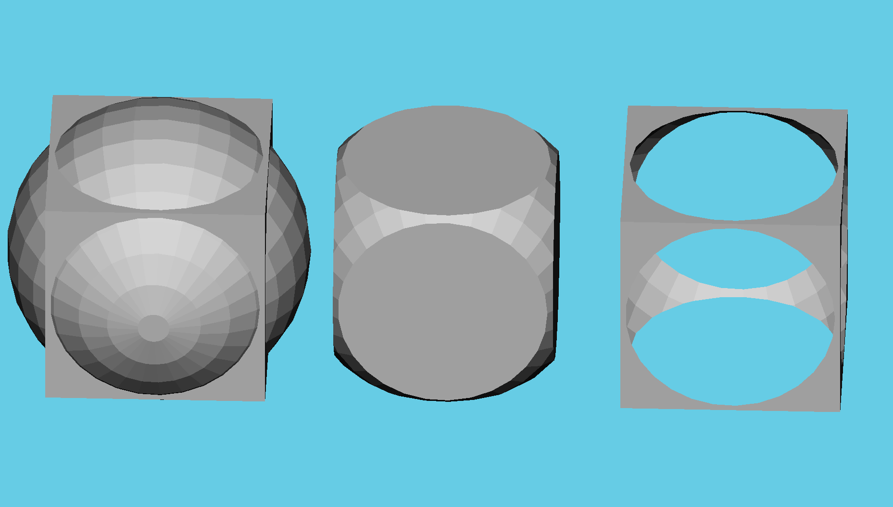
Basic Concepts
Combine primitive solids with Boolean operations
Union, Intersection, Difference

Slide 3
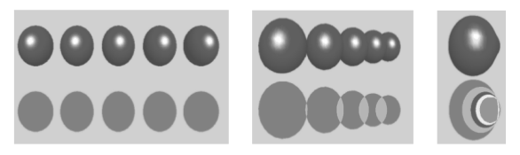
Algorithms for Image-Based CSG
Goldfeather and Layered Goldfeather
Goldfeather checks between front and back faces
Layered Goldfeather uses Depth Complexity

Slide 4
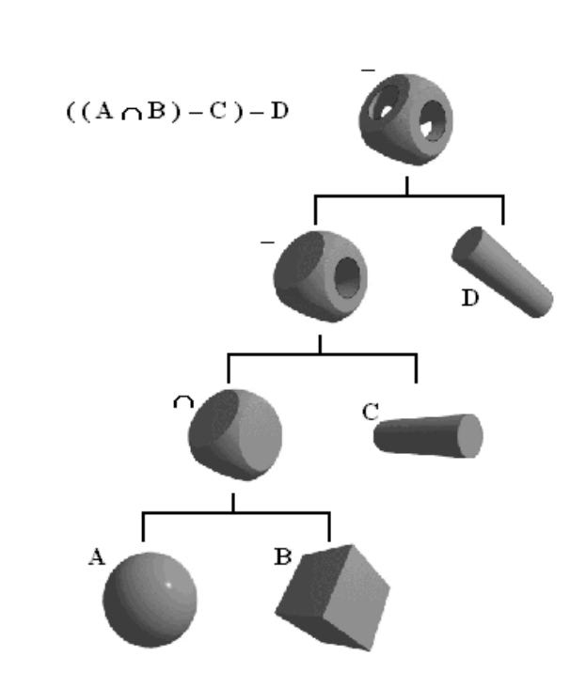
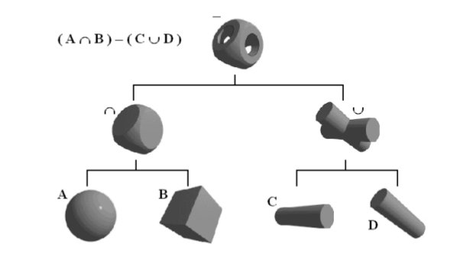
Other Techniques
Tree Organization and Normalized Trees
Using color buffer in place of z-buffer

Slide 5
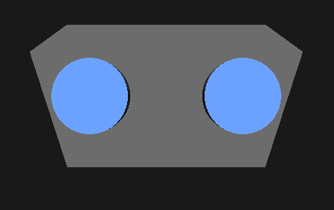

Software Challenges
Left-handed vs Right-handed Coordinate Systems
Perspective and Lighting Issues

Slide 6
Bibliography
Goldfeather, Jack, Jeff Hultquist, and Henry Fuchs. “Fast Constructive Solid Geometry in the Pixel-Powers Graphics System.” Computer Graphics, SIGGRAPH '86 Proceedings, vol. 20, no. 4, 1986, pp. 107-116
Kirsch, Florian and Jürgen Döllner. “Rendering Techniques for Hardware-Accelerated Image-Based CSG.” Journal of WSCG, vol. 12, no. 2, 2004, pp. 221-228.
Kirsch, Florian and Jürgen Döllner. “OpenCSG: A Library for Image-Based CSG Rendering.” Proceedings of the FREENIX/ Open Source Track, 2005 USENIX Annual Technical Conference. 2005.
McReynolds, Tom and David Blythe. Advanced Graphic Programming Using OpenGL. Morgan Kaufmann, San Francisco, 2005.
Ooms, Kristien. “A 3D inclusion test on large dataset.” Developments in 3D Geo-Information Sciences. Edited by Philippe De Maeyer and Tijs Neutens. Springer, New York, 2010.
Stewart, Nigel, Geoff Leach, and Sabu John. “An Improved Z-Buffer CSG Rendering Algorithm.” 1998 Eurographics / SIGGRAPH Workshop on Graphics Hardware, ACM, 25-30, 1998.
Wilt, Nicholas. Object-Oriented Ray Tracing in C++. John Wiley & Sons, New York, 1994, pp 207-227.
Ulyanov, D., D. Bogolepov, and V. Turlapov. “Interactive Visualization of Constructive Solid Geometry Scenes on Graphic Processors.” Programming and Computer Software, vol. 43, no. 4, 2017, pp. 258-267.

